Slide 1
Combinatorics -> Problem Solving
Enjoy

Slide 2
Sets and Lists
The terms of sets and lists in programing are derived from math
In math, a set is similar to computer science in that it is a container of unique items
In math, a list is a container with elements that does not need to be unique and where order matters
Set: { a, b } = { b, a }
List: (a, b) != (b, a)

Slide 3
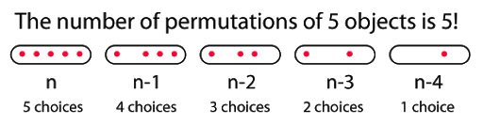
List from Set (Permutations)
Given a set of length n…
How many ways are there to arrange the n numbers in the set into a list?
We can choose n for the first item, n-1 for the second …. 1 for the last item
Therefore number of ways to choose is n!
How many ways are there to arrange k numbers where k <= n from this set into a list
We can choose n for the first item, n-1 for the second, …. n-k+1 for the last item
Therefore number of ways to choose is n!/(n-k)!

Slide 4
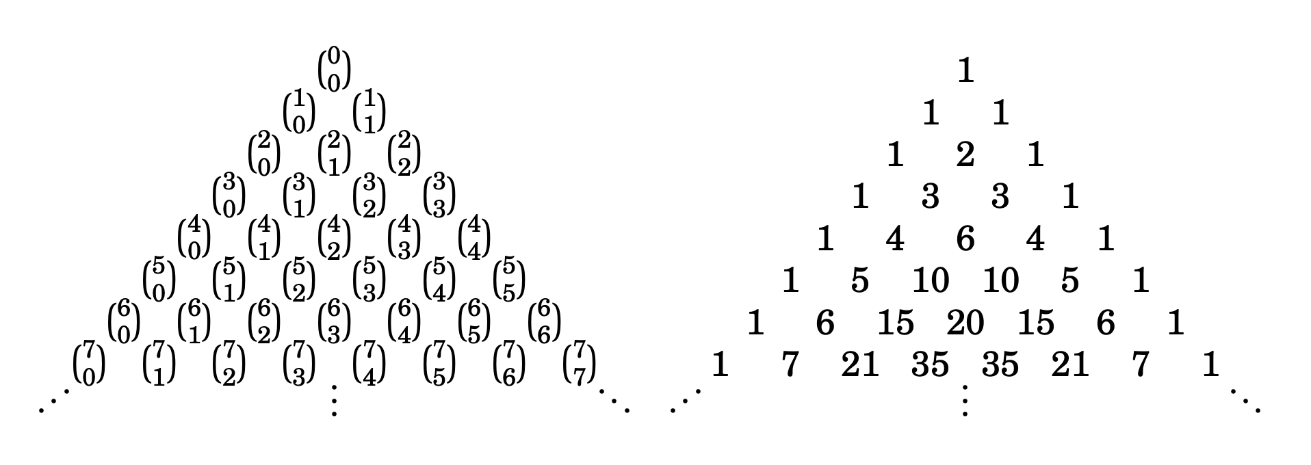
Set from Set (Combinations)
Given a set of length n …
There is only 1 way to arrange n elements into another set since { a, b } = { b, a }
How many ways can we arrange k elements from the set into another set?
If we first arrange them in a list of k-elements then are n!/(n-k)! ways (previous slide)
Keep in mind we have permuted each selection of k elements k! times when counting list
Divide by k! since we don't want to count lists with same elements but different orders
n! / (n-k)!k!
To calculate this efficiently we can use a Pascal's triangle to avoid integer overflow and stick to addition

Slide 5
Problems List
http://codeforces.com/contest/131/problem/C
https://dmoj.ca/problem/ioi96p2 (not combinatorics)
https://dmoj.ca/problem/coci18c6p3

